Slide 1

CS 513
Knowledge Discovery and Data Mining
Student Grade Pass or Fail Prediction

Slide 2

Team Members
Jiangrui Zheng
Junran Yang
Suqi Lu
Zhangyuan Han
CWID: 20012581
CWID: 20013443
CWID: 20011308
CWID:20011343

Slide 3
Problem Statement
https://www.kaggle.com/datasets/dinhanhx/studentgradepassorfailprediction
There are many factors influence performance of students including demographic, social and school-related features and so on. The final grade of students will be affected by these lots of features. Take the students' scores in the third semester(G3) as the prediction standard and set a grade greater >=10 as pass.
Therefore, our task is predicting pass with all attributes except G3. Given, a set of features we want to predict the target variable as 1, which is defaulter or 0 which is non-defaulter.

Slide 4
Dataset Explanation
This data approach student achievement in secondary education of two Portuguese schools. The dataset comprises 30 features in form of columns, out of which we may opt to use the essential features only, during implementation. We can use PCA and correlation for feature reduction, but we shall see.

Slide 5
Data fields
Variable | Description
school | student's school (binary: 'GP' - Gabriel Pereira or 'MS' - Mousinho da Silveira) (bool: 1 if it's GP else 0)
sex | student's sex (binary: 'F' - female or 'M' - male) (bool: 1 if it's F else 0)
age | student's age (numeric: from 15 to 22)
address | student's home address type (binary: 'U' - urban or 'R' - rural) (bool: 1 if it's U else 0)
famsize | family size (binary: 'LE3' - less or equal to 3 or 'GT3' - greater than 3) (bool: 1 if it's LE3 else 0)
Pstatus | parent's cohabitation status (binary: 'T' - living together or 'A' - apart) (bool: 1 if it's T else 0)
Medu | mother's education (numeric: 0 - none, 1 - primary education (4th grade), 2 - 5th to 9th grade, 3 - secondary education or 4 - higher education)
Fedu | father's education (numeric: 0 - none, 1 - primary education (4th grade), 2 -5th to 9th grade, 3 - secondary education or 4 - higher education)
traveltime | home to school travel time (numeric: 1 - 1 hour)
studytime | weekly study time (numeric: 1 - 10 hours)

Slide 6
Data Fields
Variable | Description
failures | number of past class failures (numeric: n if 1<=n<3, else 4)
schoolsup | extra educational support (binary: yes or no) (bool: 1 if it's Yes else 0)
famsup | family educational support (binary: yes or no) (bool: 1 if it's Yes else 0)
paid | extra paid classes within the course subject (Math or Portuguese) (binary: yes or no) (bool: 1 if it's Yes else 0)
activities | extra-curricular activities (binary: yes or no) (bool: 1 if it's Yes else 0)
nursery | attended nursery school (binary: yes or no) (bool: 1 if it's Yes else 0)
higher | wants to take higher education (binary: yes or no) (bool: 1 if it's Yes else 0)
insternet | Internet access at home (binary: yes or no) (bool: 1 if it's Yes else 0)
romantic | with a romantic relationship (binary: yes or no) (bool: 1 if it's Yes else 0)
famrel | quality of family relationships (numeric: from 1 - very bad to 5 - excellent)

Slide 7
Data Fields
Variable | Description
freetime | free time after school (numeric: from 1 - very low to 5 - very high)
goout | going out with friends (numeric: from 1 - very low to 5 - very high)
Dalc | workday alcohol consumption (numeric: from 1 - very low to 5 - very high)
Walc | weekend alcohol consumption (numeric: from 1 - very low to 5 - very high)
health | current health status (numeric: from 1 - very bad to 5 - very good)
absences | number of school absences (numeric: from 0 to 93)
G1 | first period grade (numeric: from 0 to 20)
G2 | second period grade (numeric: from 0 to 20)
G3 | final grade (numeric: from 0 to 20)
pass | (bool: 1 if that student passes else 0) output target

Slide 8
Preprocessing
Check the dataset for missing data
Analyzed the correlation of features (focusing on gender, age and location)
Delete features that are not highly relevant
Principal Component Analysis (PCA)
Split dataset as training set (70%) and test set (30%)
Notes:
Team members check the dataset for missing data, and fortunately, there were no missing data in the dataset.
At the same time, we also analyzed the correlation of features, focusing on the impact of gender, age and location on performance.
In terms of features, we have also done some processing to delete features that are not highly relevant, including age, gender, and address, so that the models are more realistic.
Group members also do the Principal Component Analysis. Visualization results will be presented later by other team members
Split the data set into training set and test set according to the ratio of 7:3

Slide 9
Classification Algorithms
Different classification algorithms used and their results
a. Logistic Regression
b. Support Vector Machine (SVM)
c. K-Nearest Neighbor (KNN)
d. Random Forest
e. Naive Bayes
f. Decision Tree
g. Quadratic Discriminant Analysis (QDA)
h. Percetron Learning Algorithm
Notes:
There are 8 different models that group members used to classify the dataset.(list name) Some of these model are chosen from this course and we also choose some models from outside of course.

Slide 10
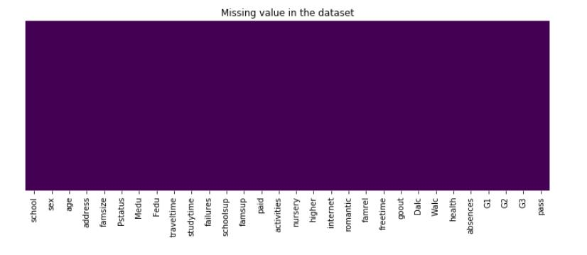
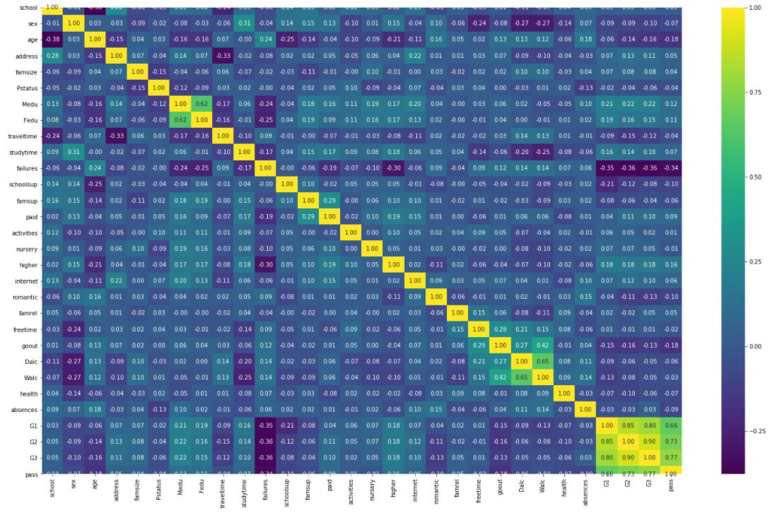
There is not any missing value.
Correlation Matrix
Notes:
Then we built a correlation Matrix. In this graph, we investigate the correlation to matrix to verify that we don't have extreme values of correlation and neither have 0 correlations amongst the values outside the main diagonal of the matrix. We can see from the correlation matrix that we have several small-moderate sized correlations.

Slide 11
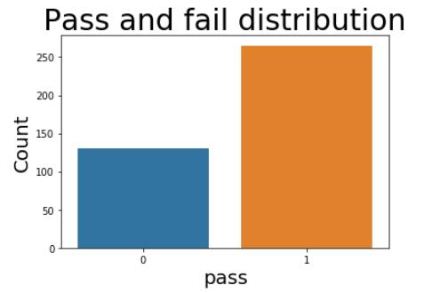
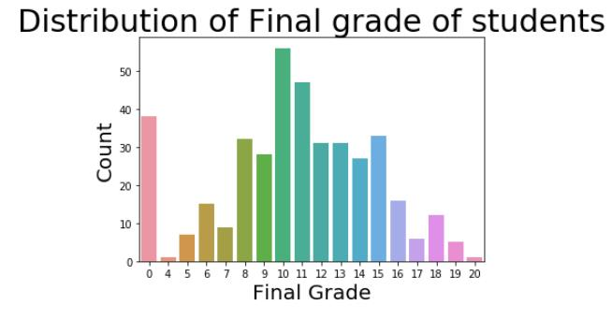
The label 1 means student passed final exam else 0. We can see most students passed final.
Notes:
The right one is distribution of G3.

Slide 12
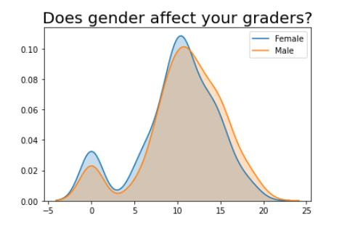
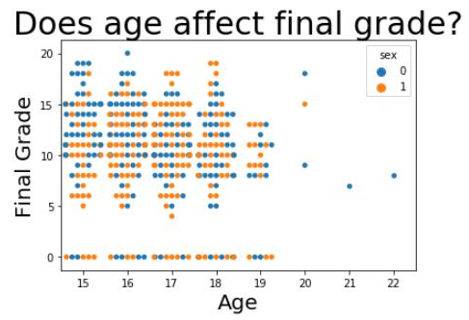
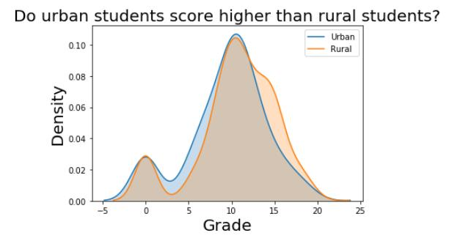
See relation between sex and grades first, there seems to be no clear relation of gender with final grade.
Similarly, we plot a scatter plot with final grade and age. It seems no clear relation of age with final grade as well
The graph shows that on there is not much difference
between the scores based on location
Notes:
So we will drop these features 'pass', 'G3','age', 'sex', 'address. We also Drop G3 because G3 is final grade. our 'pass' column is directly calculated from the G3. They we use Chi_square for feature selection and then do Data Standardisation.

Slide 13
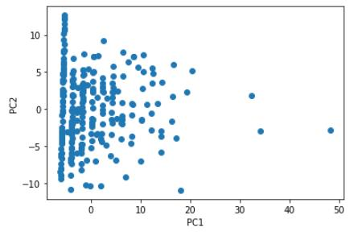
Principal Component Analysis (PCA)
Total percentage of variance:
85.34%
Strength of each of the 2 principal components:
118.75989346, 81.70028032
Notes:
Then we use PCA with 2 components. Calculate the total percentage of variance captured by the 2 PCA components. Also, report the strength of each PCA component

Slide 14
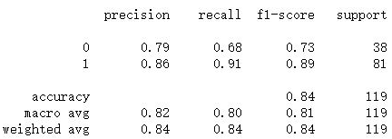

SVM without Grid Search
confusion matrix
Notes:
Support vector machine model without grid search. Create a confusion matrix and a classification report. Using SVM on Test Dataset - accuracyis 84.03361344537815 %

Slide 15
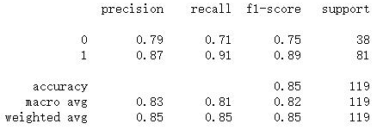

SVM with Grid Search
confusion matrix
Notes:
Support vector machine model with grid search. Create a confusion matrix and a classification report. Using SVM with gridsearch Accuracy on Test Dataset is 84.87394957983193 %

Slide 16
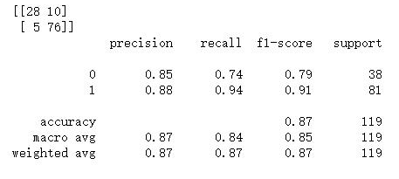
Logistic Regression
Notes:
Logistic Regression model. Create a confusion matrix and a classification report. Using Logistic Regression Model- Accuracy on Test Dataset is 87.39495798319328 %

Slide 17
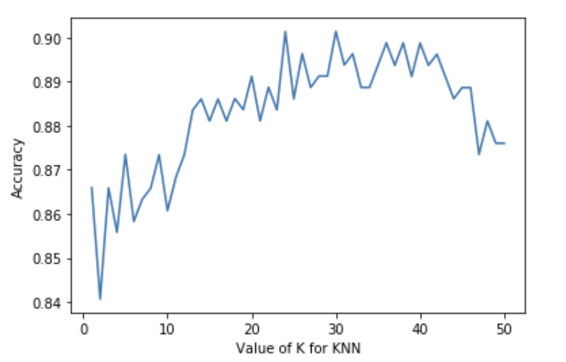
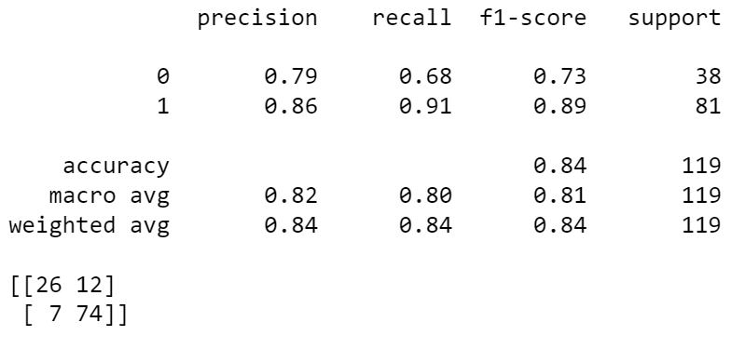
K-Nearest Neighbor (KNN)
The best value of K is 30
When K = 30, the performance of KNN
Notes:
KNN model. adjust the parameters. get the best value of K is 30. Create a confusion matrix and a classification report. Using KNN Accuracy on Test Dataset is 84 %

Slide 18
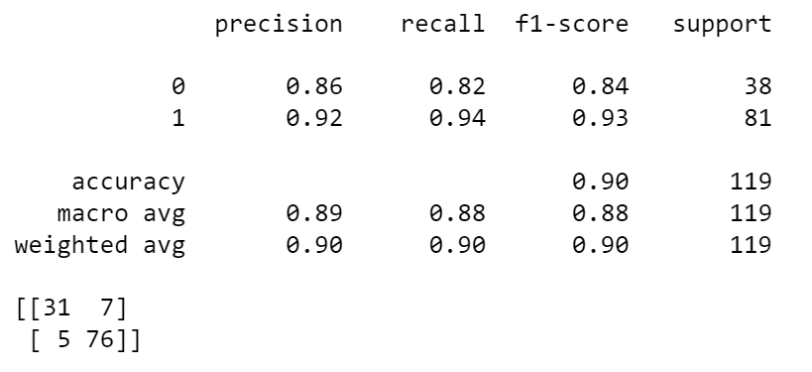
Random Forest
When n_estimators=15, the performance of Random Forest
Notes:
also use Random forest model to classfiy.Create a confusion matrix and a classification report. Using Random forest Accuracy on Test Dataset is 90 %

Slide 19
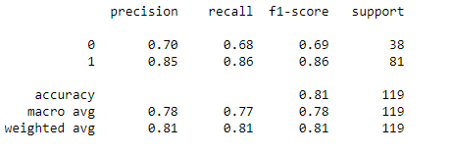

Naive Bayes
confusion matrix
Notes:
Naive Bayes model. This is confusion matrix and a classification report. Using Naive Bayes- Accuracy on Test Dataset is 81%

Slide 20
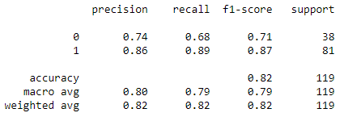

CART(Decision Tree)
confusion matrix
Notes:
Decision tree model by using CART methology. And this is the confusion matrix and atheclassification report. Accuracy on Test Dataset is 82%

Slide 21
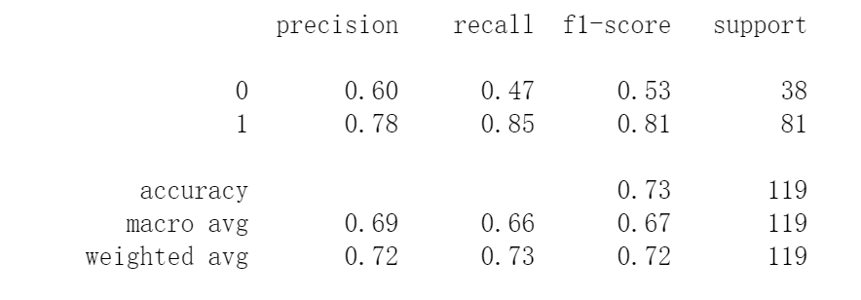

QDA(Quadratic Discriminant Analysis)
confusion matrix

Slide 22
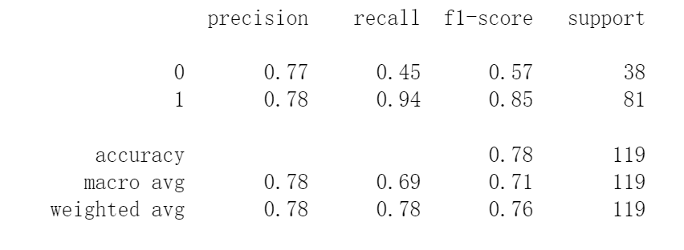

PLA(Perceptron Learning Algorithm)
confusion matrix
Notes:
Decision tree model by using CART methology. Create a confusion matrix and a classification report. Accuracy on Test Dataset is 82%

Slide 23
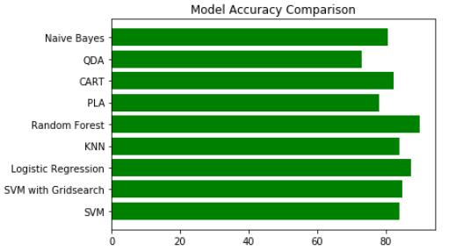
Accuracy Comparison
Random Forest has higher Accuracy Rate than other algorithm

Slide 24

Conclusion
Compare to any other algorithms, Random forest has the best performance in this dataset

